Slide 1
Online Doctor Booking Using MERN Stack
By Team Members of Final Year IT-A
Janani.S
Afrith Hussain.Z
Manoj
Bhuvaneshwari.E

Slide 2
ABSTRACT:
The online doctor booking system provides a convenient, efficient platform for patients to book medical consultations with healthcare professionals. Leveraging the MERN stack—MongoDB, Express.js, React, and Node.js—this system facilitates seamless interactions between patients and doctors, optimizing both accessibility and convenience in healthcare services.
The system enables users to register as either patients or doctors, with tailored features for each role. Patients can browse doctor profiles, filter by specialization or location, and view available time slots for appointments. With an intuitive booking interface, patients can select their preferred slot, confirm appointments, and make payments if required, all through a secure, user-friendly process. Doctors, in turn, can create profiles, manage appointment schedules, and receive real-time notifications, improving their ability to connect with patients effectively.
This system ensures data security and privacy by implementing user authentication and authorization protocols, including JWT (JSON Web Token) for session management. MongoDB is used for managing and storing user data, while Express.js and Node.js support robust backend operations, and React provides a responsive and dynamic user interface.
The online doctor booking platform ultimately addresses the growing demand for accessible healthcare by digitizing the process of booking medical appointments, making it easy for patients to access quality healthcare while helping doctors reach a broader audience.

Slide 3
1.INTRODUCTION:
In the digital age, healthcare accessibility and convenience are paramount. Traditional methods of booking doctor appointments, such as in-person visits or phone calls, often lead to inefficiencies and frustration for both patients and healthcare providers. To address these challenges, this online doctor booking system provides a modern solution that connects patients with doctors through a streamlined digital platform.
This system aims to enhance patient access to healthcare while allowing doctors to manage their appointments and schedules more efficiently. Built using the MERN stack—MongoDB, Express.js, React, and Node.js—the platform is designed to deliver a high-performance and user-friendly experience for patients and healthcare professionals alike.
1.1 PURPOSE:
The primary purpose of this project is to develop a convenient, secure, and efficient platform for patients to book appointments with doctors. The system is intended to simplify the appointment process by eliminating the need for phone calls, reducing wait times, and allowing users to book, reschedule, or cancel appointments at their convenience. For healthcare providers, this system also helps in managing schedules, reducing no-shows, and expanding their reach to more patients

Slide 4
1.2 SCOPE:
The online doctor booking system targets two main user types: patients and doctors. Patients will have access to features such as doctor search, profile viewing, real-time slot availability, and appointment booking. Doctors can manage their profiles, availability, and appointments through a dedicated interface. Additionally, the system will support secure authentication, real-time notifications, and feedback mechanisms to ensure a reliable and interactive experience.
The project scope also covers essential aspects of data privacy and security, ensuring that users’ personal and medical information is protected. The use of the MERN stack allows for flexibility, scalability, and responsiveness, creating a robust application that can cater to a growing number of users and features.
1.3 OBJECTIVE:
The online doctor booking system is developed with the following key objectives:
Enhance Patient Access to Healthcare Services: Make it easier for patients to find and book appointments with healthcare providers quickly and conveniently.
Streamline Appointment Scheduling: Allow patients to view available slots in real time and
book or manage appointments without the need for direct contact with the clinic, thus
reducing scheduling conflicts and wait times.

Slide 5
Support Doctor-Patient Communication: Enable a seamless flow of information between patients and doctors, including appointment reminders and feedback options.
Ensure Security and Privacy: Protect users' sensitive data by implementing secure authentication and data handling processes.
Create a Scalable and User-Friendly Platform: Utilize the MERN stack to build an intuitive, responsive, and efficient application capable of handling a large user base.
2.SYSTEM REQUIREMENT:
2.1 HARDWARE:
Processor: Minimum Intel i3 or equivalent
RAM: 8 GB (recommended for smooth development experience)
Storage: 256 GB SSD (recommended), or minimum 500 GB HDD
Graphics: Standard integrated graphics for local development
2.2 SOFTWARE:
Operating System: Windows 10, MacOS, or Linux
Development Environment: Visual Studio Code, WebStorm, or similar IDEs
Front-End: React.js
Back-End: Node.js with Express.js framework
Database: MongoDB (NoSQL Database)

Slide 6
2.3 NETWORK:
Internet Connectivity: Required for initial setup, database access (if using a cloud-based MongoDB), and package installations
Server: Deployment on cloud servers (AWS, Heroku, or similar), or local server for testing.
3. ARCHITECTURE:
Front-End: The React.js application is responsible for rendering the UI and interacting with the backend via API calls.
Back-End: The server, built with Node.js and Express.js, manages client requests and performs business logic.
Database: MongoDB stores user data, doctor profiles, appointment information, and feedback data.
Deployment: The entire stack is hosted on a cloud platform, with options like AWS, Heroku, or DigitalOcean for scalability.
3.1 TECHNICAL ARCHITECTURE:

Slide 7
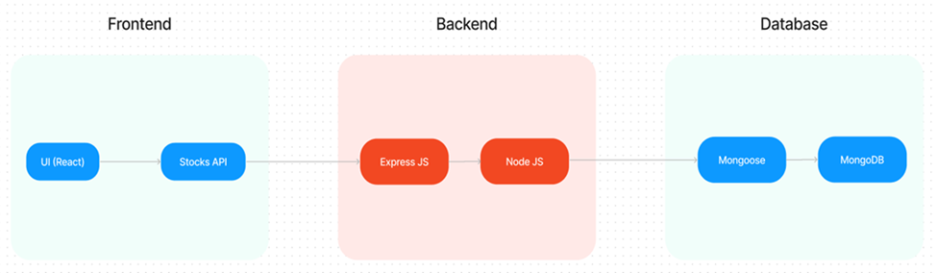
Creating a technical architecture for a doctor booking system using the MERN stack involves setting up components for each part of the stack (MongoDB, Express, React, Node.js) to handle various parts of the system, including data management, API endpoints, and frontend UI. Here’s an overview of a typical architecture:
1. Frontend: React
Description: The user-facing part of the system where patients can view doctor profiles, search for specialists, book appointments, and leave feedback.
Components:
Patient Portal: Contains pages for searching and booking doctors, viewing bookings, and providing feedback.

Slide 8
Doctor Portal: Allows doctors to view their bookings, manage availability, and respond to feedback.
Admin Dashboard (optional): For managing doctors, appointments, and reviews.
State Management: Use a state management library like Redux for managing user session data, booking states, and feedback.
Authentication: JWT tokens stored in cookies or local storage to manage user sessions.
2. Backend: Node.js + Express
Description: Manages the application’s server-side logic, APIs, and communication between the frontend and the database.
API Endpoints:
User Authentication: Sign-up, login, and JWT-based authentication for security.
Booking Management: Endpoints for creating, viewing, updating, and deleting bookings.
Doctor Management: Allows creation and management of doctor profiles, including availability and specialization.

Slide 9
Feedback Management: Endpoints for patients to submit feedback and for viewing reviews.
Middleware: JWT authentication middleware to protect routes that require user login (e.g., booking or viewing appointments).
Error Handling & Logging: Implement robust error handling and logging mechanisms using libraries like Winston.
3. Database: MongoDB
Description: Stores application data, such as patient and doctor information, appointment records, and feedback.
Collections:
Users: Stores patient and doctor information (e.g., name, contact details, password hash).
4. Additional Features:
Real-Time Notifications: Integrate WebSocket or Firebase for real-time updates, like new bookings or changes in appointment status.
Email or SMS Notifications: Trigger notifications for appointment confirmations, reminders, and updates.

Slide 10
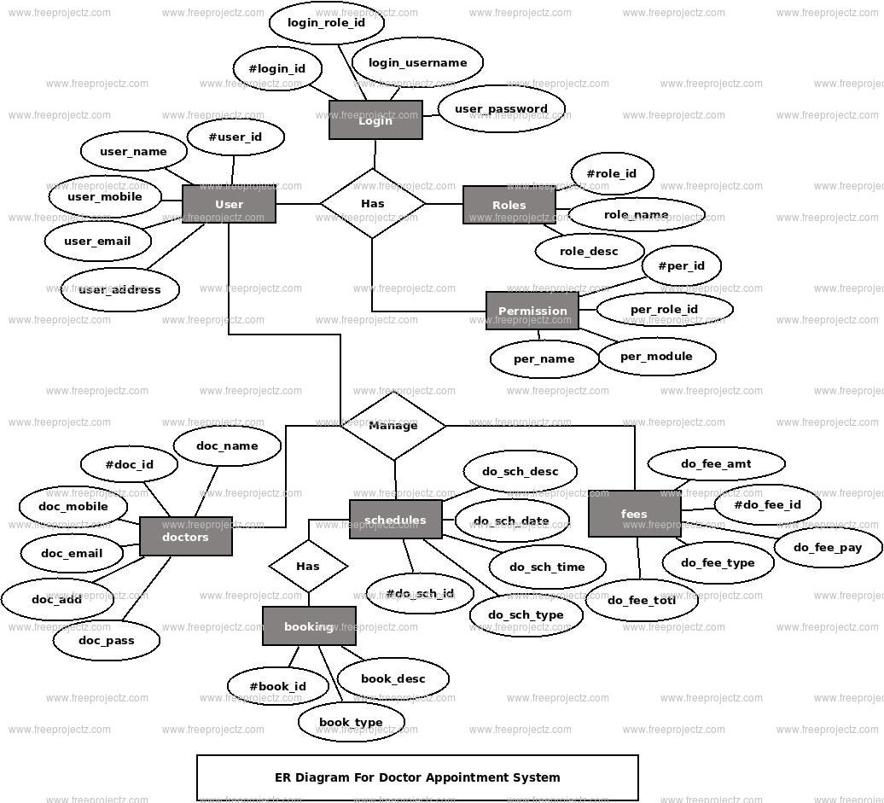
4.ER DIAGRAM:

Slide 11
An ER (Entity-Relationship) Diagram visually represents the relationships and structure of a database for a specific system—in this case, an online doctor booking system. Here’s a breakdown of the components and their roles within this system.
This ER diagram helps to:
Design the Database Structure: Ensures that all key components of the system are accounted for and linked properly.
Clarify Relationships: Shows how entities (e.g., Patient and Doctor) interact, helping avoid redundant or conflicting relationships.
Optimize Database Queries: Helps in deciding which fields to index and how to manage queries efficiently (e.g., searching appointments by DoctorID).
In summary, this ER diagram serves as a blueprint for structuring the doctor booking system’s database, ensuring that data is organized, easily accessible, and correctly interlinked. This foundation is essential for efficient data storage and retrieval, especially in a system involving multiple interactions between patients, doctors, and appointments.

Slide 12
6.PROJECT STRUCTURE:
A typical project structure for a doctor booking system using the MERN (MongoDB, Express, React, Node.js) stack would look something like this. This structure organizes code by responsibility, ensuring scalability, easy maintenance, and separation of concerns.
doctor-booking-system/
├── client/ # React Frontend
│ ├── public/ # Static files (HTML, images, etc.)
│ │ ├── index.html # Main HTML file
│ │ └── favicon.ico
│ ├── src/
│ │ ├── assets/ # Images, icons, fonts, etc.
│ │ ├── components/ # Reusable UI components (e.g., buttons, form inputs)
│ │ ├── pages/ # Page components (e.g., Home, DoctorProfile, Booking)
│ │ ├── services/ # Functions to make API requests
│ │ ├── App.js # Main app component
│ │ ├── index.js # React entry point
│ │ ├── routes.js # Route definitions (React Router)
│ │ ├── store/ # State management files (e.g., Redux)
│ │ └── styles/ # CSS or Sass files
│ └── package.json # Client dependencies and scripts

Slide 13
5. APPLICATION FLOW:
User Registration: Users sign up as either a patient or a doctor.
Doctor Profile Creation: Doctors create profiles, set specializations, and update availability.
Search and Book: Patients search for doctors, view availability, and book appointments.
Appointment Management: Doctors and patients can view, reschedule, or cancel appointments.
Notifications and Feedback: Patients receive appointment notifications, and feedback options are provided after consultation.
6.PROJECT SETUP & CONFIGURATION:
6.1 FRONT-END DEVELOPMENT:
Install Dependencies: Run npm install in the /client directory.
Main Libraries: React, Axios (for API requests), Material-UI or Bootstrap (for styling).
Component Structure: Design reusable components (e.g., Navbar, ProfileCard, Appointment Form).
Routing: Use React Router for navigation.
State Management: Context API or Redux for state sharing across components.

Slide 14
6.2 BACK-END DEVELOPMENT:
Install Dependencies: Run npm install in the /server directory.
Main Libraries: Express.js, Mongoose (for MongoDB interaction), JWT (for authentication).
API Structure: Design RESTful APIs for managing users, appointments, and doctor profiles.
Authentication: Use JWT to secure API routes and manage sessions.
Middleware: Set up middleware for error handling, logging, and authentication.
6.3 DATABASE DEVELOPMENT:
Database Setup: Use MongoDB Atlas or local MongoDB.
Schema Design: Define schemas for User, Doctor, Appointment, and Feedback using Mongoose.
Relationships: Connect users with appointments, doctors with profiles, and feedback with users.

Slide 15
7.PROJECT IMPLEMENTATION:
Index.html:
<!DOCTYPE html>
<html lang="en">
<head>
<meta charset="utf-8" />
<meta name="viewport" content="width=device-width, initial-scale=1" />
<meta name="theme-color" content="#000000" />
<meta
name="description"
content="Web site created using create-react-app"
/>
<title>Book a Doctor</title>
</head>
<body>
<noscript>You need to enable JavaScript to run this app.</noscript>
<div id="root"></div>
</body>
</html>

Slide 16
CONCLUSION
This project outlines the development of a comprehensive appointment booking system with user roles for customers, doctors, and admin. Each milestone—setup, backend, database, frontend, and final implementation—forms a structured foundation for a scalable application. The integrated functionalities allow for seamless appointment management, user authentication, and role-specific operations.

